Slide 1

Aws Cloud Virtual Internship
by
K.DEEPIKA
Roll No. 214G1A3218
Department of Computer Science and Engineering (Data Science)
Srinivasa Ramanujan Institute of Technology
(Affiliated to JNTUA & Approved by AICTE) (Accredited by NAAC with ‘A’ Grade & Accredited by NBA (EEE, ECE & CSE)
Rotarypuram Village, B K Samudram Mandal, Ananthapuramu – 515701.
2024 - 2025

Slide 2



Contents
AWS Cloud Virtual Internship
Course Objective
Introduction
Technology
Applications
Modules
Real Time applications
Learning outcomes
GitHub Link
Queries
214G1A3218

Slide 3
Course Objective
AWS Cloud Virtual Internship
The objectives of the AWS Training Course are to provide participants with a thorough understanding of AWS cloud services and their applications. Throughout the course, participants will gain hands-on experience in deploying and managing AWS resources, ensuring security, and optimizing costs.
Understand Cloud Concepts: Learn the basics of cloud computing and AWS services.
Explore AWS Core Services: Get familiar with key AWS services like EC2, S3, and RDS.
Deploy and Manage Resources: Gain hands-on experience in setting up and managing AWS resources.
Learn Security Best Practices: Understand AWS security features and compliance.
Optimize Performance and Costs: Learn to optimize resources for cost-efficiency and performance.
Prepare for Certification: Build knowledge and skills for AWS certification exams.
214G1A3218

Slide 4

Introduction
AWS Cloud Virtual Internship
What is AWS?
AWS (Amazon Web Services) is the most comprehensive and widely used cloud platform in the world today.
Launched in 2006, it includes a combination of
Infrastructure-as-a-Service (IaaS), Platform-as-a-
Service (PaaS), and Software-as-a-Service (SaaS).
AWS offers over 200 fully featured services. It allows you to select the programming language, database, operating system, web application platform, and other needed services.
behind everything your organization does: buying, selling, paying, collecting, shipping, and so on. When
214G1A3218

Slide 5
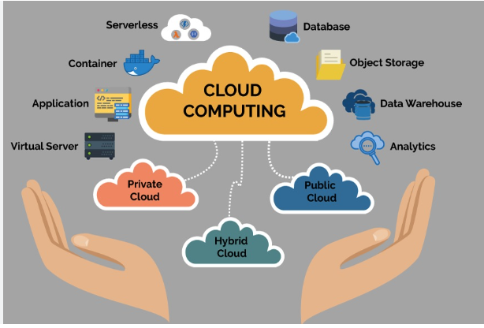
Technology
AWS Cloud Virtual Internship
Amazon Web Services (AWS) technology is a comprehensive suite of cloud computing services provided by Amazon. It aims to offer scalable, reliable, and cost-effective cloud infrastructure and platform services to individuals, businesses, and governments, enabling them to innovate and deploy applications more efficiently.
Compute
Storage
Databases
Networking
Security and Identity
Machine Learning and AI
214G1A3218

Slide 6
Technology
AWS Cloud Virtual Internship
1. Compute
AWS Compute services, such as Amazon EC2 and AWS Lambda, offer scalable and flexible virtual servers and serverless computing. They allow you to run applications without managing physical hardware, providing both high performance and cost efficiency. Compute resources can be adjusted based on workload demands, enabling optimal use of resources.
2. Storage
AWS Storage services, including Amazon S3 and Amazon EBS, provide scalable and durable solutions for storing data. They support a wide range of use cases from object storage to block storage and archival.
3. Databases
AWS Databases, such as Amazon RDS and DynamoDB, offer managed database solutions for both relational and NoSQL needs. They simplify database management tasks like backups, scaling, and patching. These services provide high performance, availability, and security for your data
214G1A3218

Slide 7
Technology
AWS Cloud Virtual Internship
4. Networking
AWS Networking services, including Amazon VPC and AWS CloudFront, enable you to build and manage secure, high-performance networks. They support global content delivery and ensure seamless communication between resources. Network configurations can be customized to fit specific application needs and security requirements.
5. Security and Identity
AWS Security and Identity services, such as AWS IAM and AWS KMS, provide robust tools for managing access and protecting data. They allow you to control user permissions, encrypt sensitive information, and monitor security events. These services help ensure compliance and safeguard your cloud environment.
6. Machine Learning and AI
AWS Machine Learning and AI services, like Amazon SageMaker and AWS Rekognition, enable the development and deployment of intelligent applications.They provide pre-built models and frameworks for tasks such as image recognition and natural language processing.
214G1A3218

Slide 8
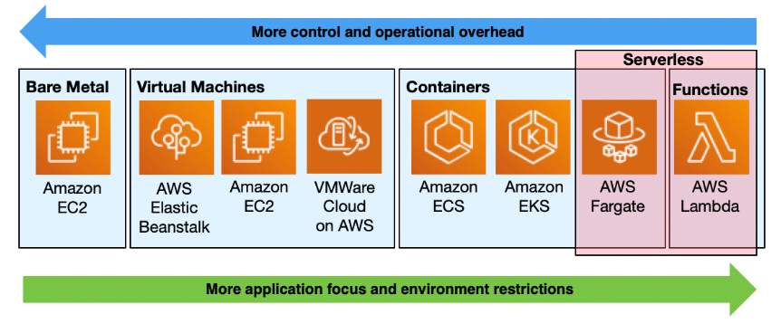
Applications
AWS Cloud Virtual Internship
AWS provides a broad range of services that enable businesses to deploy and manage applications efficiently in the cloud. From scalable web hosting and robust data storage solutions to advanced machine learning and big data analytics, AWS supports diverse use cases across industries. Its flexible and cost-effective platform helps organizations innovate faster and scale resources seamlessly according to their needs.
behind everything your organization does: buying, selling, paying, collecting, shipping, and so on. When
214G1A3218

Slide 9
Applications
AWS Cloud Virtual Internship
1. Web Hosting
Scalable Website Deployment: Host and scale websites and web applications with services like Amazon EC2, Amazon S3, and AWS Elastic Beanstalk. Achieve high availability and manage traffic spikes effortlessly.
2. Mobile Application Development
Efficient App Deployment: Develop, test, and deploy mobile apps with AWS Amplify and AWS Device Farm. Ensure cross-platform compatibility and performance on real devices.
3. IoT Solutions
Connected Device Management: Connect and manage IoT devices with AWS IoT Core and AWS IoT Greengrass. Analyze data from IoT devices and implement local processing.
4. Healthcare
Data Management and Analytics: Store and analyze health records with Amazon HealthLake and other AWS services. Ensure healthcare regulations and enhance patient care.
behind everything your organization does: buying, selling, paying, collecting, shipping, and so on. When
214G1A3218

Slide 10
Modules
AWS Cloud Virtual Internship
Compute: Includes Amazon EC2 for scalable virtual servers, AWS Lambda for serverless computing, and Amazon ECS for container management.
Storage: Features Amazon S3 for scalable object storage, Amazon EBS for block storage, and Amazon Glacier for archival storage.
Database: Provides Amazon RDS for relational databases, Amazon DynamoDB for NoSQL databases, and Amazon Redshift for data warehousing.
Networking: Covers Amazon VPC for isolated networks, Amazon Route 53 for DNS, and AWS CloudFront for content delivery.
Machine Learning: Includes Amazon SageMaker for model building, AWS Recognition for image analysis, and Amazon Comprehend for natural language processing.
Analytics: Features Amazon EMR for big data processing, Amazon Kinesis for real-time data streaming, and Amazon QuickSight for business intelligence.
Business processes are the lifeblood of your company. There’s a process behind everything your organization does: buying, selling, paying, collecting, shipping, and so on. When
214G1A3218

Slide 11
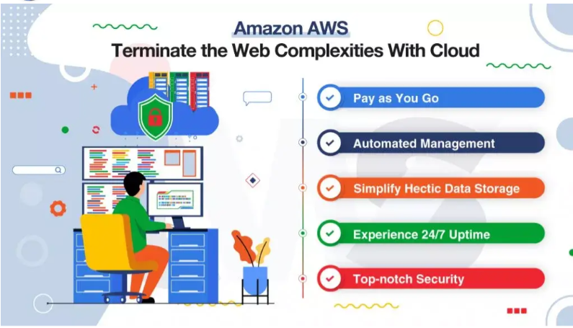
How Does AWS Works?
AWS Cloud Virtual Internship
Business processes are the lifeblood of your company. There’s a process behind everything your organization does: buying, selling, paying, collecting, shipping, and so on. When
214G1A3218

Slide 12
How Does AWS Work?
AWS Cloud Virtual Internship
Pay-as-You-Go Pricing: AWS uses a pay-as-you-go pricing model, where you pay only for the resources and services you use. This helps manage costs and aligns expenses with actual usage.
Automated Management: AWS offers tools and services to automate tasks such as scaling, backups, and monitoring. This simplifies infrastructure management and enhances efficiency.
Secure Environment: AWS provides robust security features, including encryption, identity management, and compliance tools, to protect data and applications.
Experience 24/7 Uptime: AWS ensures high availability by hosting services in multiple data centers around the world, allowing for continuous operation and minimal downtime.
Top-Notch Security: AWS delivers advanced security features, including multi-layered encryption, comprehensive identity and access management, and continuous monitoring, to ensure the protection and integrity of your data and applications.
Business processes are the lifeblood of your company. There’s a process behind everything your organization does: buying, selling, paying, collecting, shipping, and so on. When
214G1A3218

Slide 13

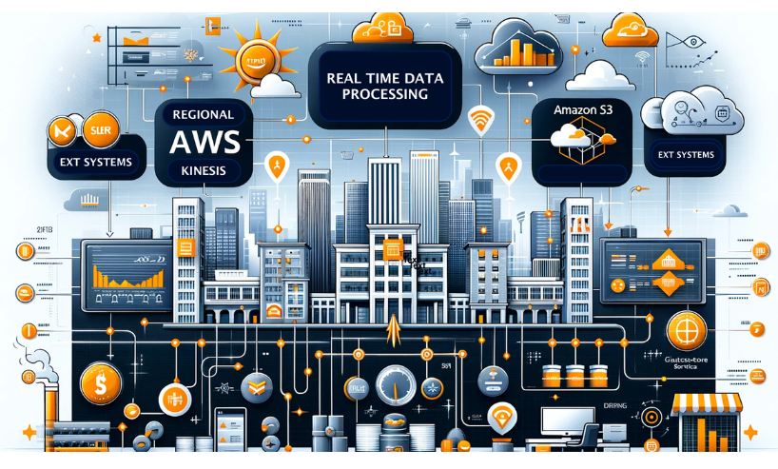
Real Time Applications
AWS Cloud Virtual Internship
Big Data
Amazon Cognito
Amazon Dynmo DB
AWS Device farm
AWS Lambda
Computing
Storage
Database
Networking
214G1A3220

Slide 14
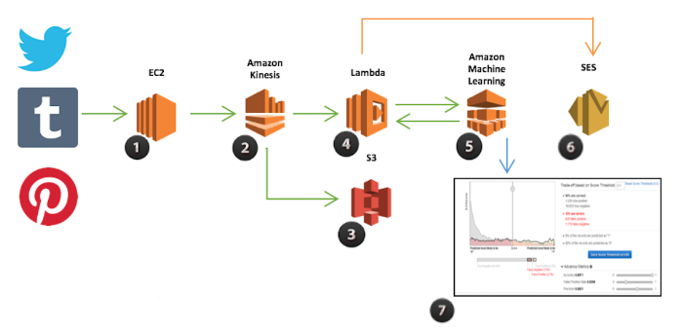
Real Time Applications
AWS Cloud Virtual Internship
1. Big Data
One of the biggest challenges faced by companies these days is Big Data. The companies are struggling to store their large amounts of data using traditional methods. With AWS Big Data storage services, they can manage to store their data even if the data limit increases unexpectedly as AWS provides virtually unlimited data storage with scale-in and scale-out options. AWS offers easy access and faster data retrieval as well
214G1A3218

Slide 15
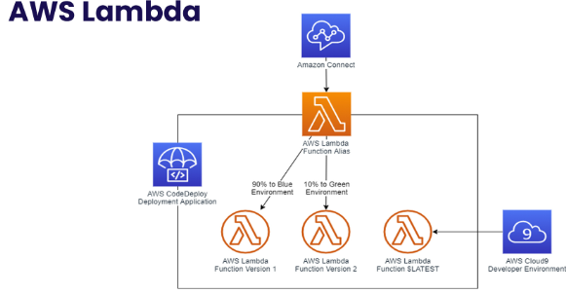
Real Time Applications
AWS Cloud Virtual Internship
2. AWS Lambda:
AWS Lambda eases the work of the mobile developer by managing the whole thing by themselves. AWS allows you to run the code according to the events and ease provisioning the servers or handling them. You need to upload the code, and Lambda will deal with the rest of the things, including scalability.
214G1A3218

Slide 16
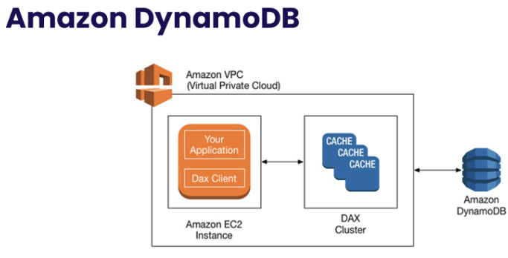
Real Time Applications
AWS Cloud Virtual Internship
3. Amazon Dynamo DB:
Amazon Dynamo DB is a NoSQL (not only SQL) cloud database service that can store and retrieve a large amount of data or traffic according to the user’s demand. Its database service is extremely fast, which offers steady, single-digit millisecond latency at any level.
214G1A3218

Slide 17
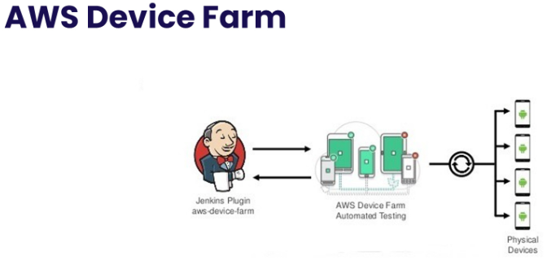
Real Time Applications
AWS Cloud Virtual Internship
4. AWS Device Farm:
It is an app testing service that allows you to test different apps on real mobile devices hosted by AWS. There are two methods to use this service. Automated Testing allows you to test the app with various physical devices in the AWS Cloud platform. Remote Access allows you to assess the devices in real-time from the web browser. You can test your Android, iOS, and web applications compared to real mobile devices in the cloud app.
214G1A3218

Slide 18
Learning Outcomes
AWS Cloud Virtual Internship
AWS aims to provide scalable, flexible, and cost-effective cloud computing solutions to help businesses deploy, manage, and scale applications and infrastructure based on their specific needs and workloads, leveraging a broad range of services and tools to optimize performance and drive innovation.
Understand Cloud Concepts: Learn the basics of cloud computing and AWS services.
Use Core Services: Get proficient with Amazon EC2, S3, RDS, and other core AWS services.
Manage Infrastructure: Set up and manage AWS environments, including VPCs and security.
Implement Security: Apply AWS security best practices and use tools like IAM and CloudWatch.
Optimize Costs: Estimate and manage costs with AWS pricing tools and optimization techniques.
Business processes are the lifeblood of your company. There’s a process behind everything your organization does: buying, selling, paying, collecting, shipping, and so on. When
214G1A3218

Slide 19
Conclusion
AWS Cloud Virtual Internship
In conclusion, AWS stands out as a transformative platform that revolutionizes how businesses approach cloud computing and digital infrastructure.
By harnessing a wide array of scalable and flexible services, AWS enables organizations to deploy, manage, and optimize their applications with precision and agility.
This shift from traditional on-premises solutions to a cloud-based model empowers businesses to innovate rapidly, reduce costs, and respond to evolving demands effectively.
AWS fosters collaboration and efficiency across teams by providing a unified environment where resources can be seamlessly integrated and managed.
Business processes are the lifeblood of your company. There’s a process behind everything your organization does: buying, selling, paying, collecting, shipping, and so on. When
214G1A3218

Slide 20
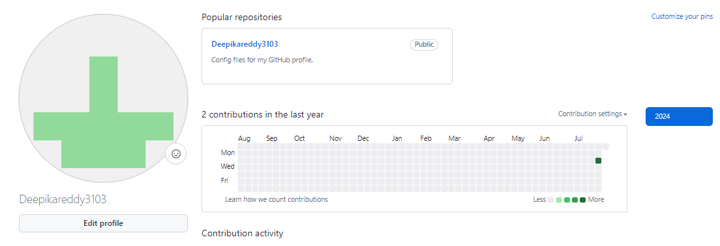
Git Hub Dashboard
AWS Cloud Virtual Internship
Repository Name : Summer Internship – II
Git Hub Link: https://github.com/Deepikareddy3103
214G1A3218

Slide 21
AWS Cloud Virtual Internship
Any Queries?
214G1A3218

Slide 22
Thank You!!!
214G1A3220

